Slide 1
HiveD
Sharing a GPU Cluster for Deep Learning with Guarantees
OSDI’20
CS219
Chenglai Huang, Jesse Huang, Lihang Liu, Raghav Dhall

Slide 2
Outline
Background
HiveD Design
Implementation
Evaluation
Summary

Slide 3
Background
Nowadays, deep learning tasks usually run on a GPU cluster
Shared by multiple tenants
Reservation is needed for guaranteed resource availability
The reserving mechanism is based on quota (# of GPUs)
User usually also specifies the GPU affinity

Slide 4
Background
GPU Affinity
User specifies an affinity(# nodes, # GPUs per node) when submitting their job
e.g. 8x8, 32x2, 64x1
Resource manager will satisfy the affinities in a hard(guaranteed) or soft(best-effort) manner
A job with hard affinity requirement will stay in the queue if its affinity could not be satisfied

Slide 5
Background
GPU Affinity
Problem: Quota is not affinity-aware!
Node 1
Node 2
Node 3
Node 4
1
2
3
4
1
2
3
4
1
2
3
4
1
2
3
4
job
job
job
Same PCIe Switch
Cross-switch
(40% slowdown)
Cross-machine
(5x slowdown!)
They are all equivalent in quota usage! (2 GPUs)

Slide 6
Background
Sharing Anomaly
Sharing Anomaly: Even a tenant has enough GPU quota, a job cannot run because of the affinity restriction and resource fragmentation caused by others
Similar to external memory fragmentation, but it is across tenants
Quota cannot isolate fragmentation across tenants
Shared Cluster
Private Cluster
Available
In Used
1
2
3
4
1
2
3
4
1
2
3
4
J
J
J
J
4 GPU Job
4 GPU Job
Wait longer or run slower?

Slide 7
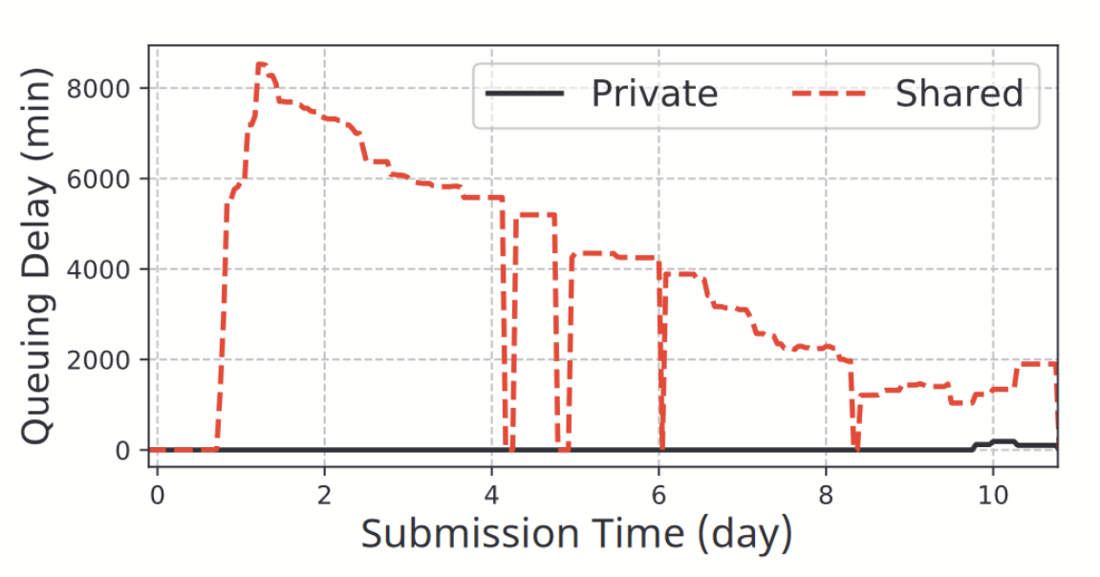
Background
Sharing Anomaly
Users are reverting to private clusters!
A tenant suffers longer queuing delay in a shared cluster than in its own private cluster

Slide 8
HiveD Design
System Overview
Goal: get rid of sharing anomaly and ensure sharing safety
If a sequence of GPU request can be satisfied in a private cluster, they should also be satisfied in the corresponding VC and shared physical cluster

Slide 9
HiveD Design
Two-Layer Architecture
HiveD has a two-layer architecture
Virtual Private Cluster (VC)
Each tenant is presented with a VC
Each VC is assigned a set of cells
Form a VC view with the GPU affinity structure which schedulers could use for resource allocation
Physical Cluster

Slide 10
HiveD Design
Cells
Captures quota as well as GPU affinity
Logical structure to bound to physical cells
Dynamic cell bounding gives benefit to the system

Slide 11
HiveD Design
Hierarchical Structures
Level-1 cell: GPU
1

Slide 12
HiveD Design
Hierarchical Structures
Level-2 cell: PCIe Switch
1
2

Slide 13
HiveD Design
Hierarchical Structures
Level-3 cell: CPU Socket
CPU
1
2
3
4

Slide 14
HiveD Design
Hierarchical Structures
Level-4 cell: Node
CPU
QPI
CPU
1
2
3
4
5
6
7
8

Slide 15
HiveD Design
Buddy Cell Allocation Algorithm
Ensure safe sharing by dynamically binding cells in VC to cells in physical clusters
Reduce fragmentation and preemption
Support low-priority jobs with unused GPU resources to improve cluster utilization

Slide 16
HiveD Design
Buddy Cell Allocation Algorithm: Theorem
The algorithm can satisfy all legal requests under a feasible VC assignment under the condition of hierarchical uniform composability.

Slide 17
HiveD Design
Buddy Cell Allocation Algorithm: Pre-conditions
Keep tracks of (1) the binding information and (2) a global free list of unallocated physical cells at each level
Keep available cells at highest possible level
Algorithm ensures that requests are legal under the assigned quota for the VC
Cells demonstrate hierarchical uniform composability

Slide 18
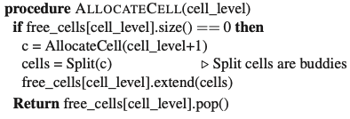
HiveD Design
Buddy Cell Allocation Algorithm: Allocating Cells
Starts at level k
If there’s no free level-k cell, go up level by level to level-l until there’s a free cell
Split level-l cell until level-k is available

Slide 19
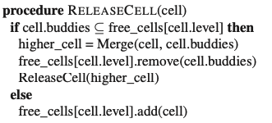
HiveD Design
Buddy Cell Allocation Algorithm: Releasing Cells
Starts at level-k
Add the released cell c to the free list at level-k and check its buddy cells
If the buddy cells are free, merge the released cell c and its buddy cells recursively to the upper level, until no cells can be merged

Slide 20
HiveD Design
Buddy Cell Allocation Algorithm: An Extension
Extend the algorithm to support low priority jobs whose cells are occupied by others, therefore improving GPU resource utilization
Maintain two cell views, one for high-priority jobs and one for low priority jobs, that manage same set of cells with the same algorithm
For allocating high-priority cells, choose cells with fewest GPU occupied by low-priority tasks; for low-priority jobs, choose cells farthest from those occupied by high-priority jobs
Notes:
Allocating Allocating Low-priority Cells Low-priority Cells

Slide 21
HiveD Design
Buddy Cell Allocation Algorithm: Summary
Hierarchical uniform composability ensures the algorithm’s correctness and efficiency
Reduces GPU fragmentation efficiently
Improves GPU utilization for tasks with multiple priority levels

Slide 22
Implementation
Integrated into OpenPAI, Microsoft’s open source platform for AI model training and resource management
Extends the Kubernetes Scheduler for GPU clusters with multiple tenants and acts as a supplement to the default scheduling logic
Running reliably on various types of GPU clusters for over 12 months (as of Nov ‘20)
Tested on long-lasting as well as short-lived jobs

Slide 23
Implementation
Cell Specification
HiveD uses a cell specification to understand the cell hierarchies and the cell assignments for the VCs
consists of a cell hierarchy, physical hierarchy and vcAssignment
cell hierarchy - describes the different levels of the cell structure along with the type of cells
physical hierarchy - cell layout in the physical cluster
vcAssignment - cell assignment for different VCs

Slide 24
Implementation
Faulty Hardware
Buddy cell algorithm detects the faulty hardware and prefers binding to a healthy cell if possible
If this is not possible, it binds to the faulty cell preemptively so that the third party scheduler in the VC becomes aware of this faulty hardware
The third party scheduler can then avoid using the GPUs in that cell until necessary

Slide 25
Implementation
Fault Tolerance
HiveD process is deployed as a Kubernetes StatefulSet, which guarantees it will run as a persistent unique instance
centralized data structures are used to store information that is required for cell allocation
cell binding decisions for each pod in the cluster are stored in annotations, a method provided by Kubernetes to bind metadata to an object
When recovering from a crash, HiveD can reconstruct all the centralized data structures from the pod annotations

Slide 26
Implementation
Fault Tolerance
If HiveD suffers a crash while scheduling the pods for a job, it can use the pod annotations to detect the unscheduled pods and can continue with the scheduling
If none of the pods of a job had been scheduled, the job manager, which is also a single instance Kubernetes StatefulSet, will receive a timeout for the job and resubmit it to the cluster
The fault tolerance of the third party scheduler is handled by the scheduler itself

Slide 27
Implementation
Reconfiguration
Cluster operator may change the cell specification to reconfigure a cluster
Similar to crash recovery
Detects changes in the old pod bindings by comparing them to the new cell specifications and makes the necessary modifications to the cell bindings, job scheduling, etc.

Slide 28
Evaluation
Setup
A 2-month trace is collected from a production cluster
279 8-GPU nodes (2,232 GPUs) shared by 11 tenants
The trace contains 141,950 deep learning jobs
Experiments are run on a 96-GPU cluster
24 virtual machines(NC24), each with 4 NVIDIA K80, on Azure

Slide 29
Evaluation
Sharing Safety
Tested on the most popular deep learning schedulers
YARN-CS, Gandiva, Tiresias
3 different cluster configurations
Tenants run jobs in private clusters
Tenants share the cluster using quota
Tenants share the cluster with HiveD enabled
HiveD use 4-level cell hierarchy

Slide 30
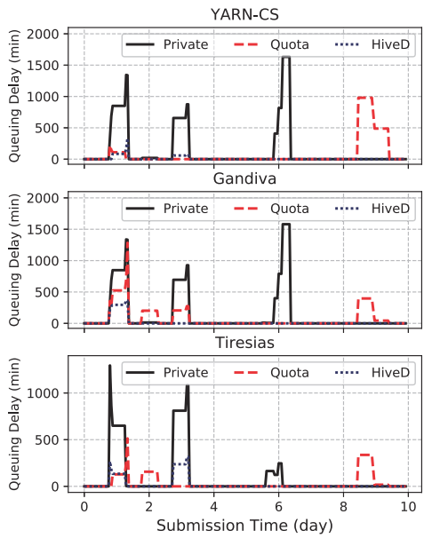
Evaluation
Sharing Safety
Queueing delays from sharing anomalies
HiveD eliminates all sharing anomalies in quota approach

Slide 31
Evaluation
Sharing Safety
Queueing delay in private clusters
HiveD also reduces queuing delay in the shared cluster when a tenant runs out of capacity in the private cluster, by giving it chances to run low-priority jobs.

Slide 32
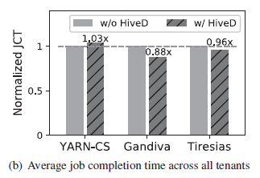
Evaluation
Sharing Safety and Performance
With sharing safety, HiveD still preserves scheduling efficiency

Slide 33
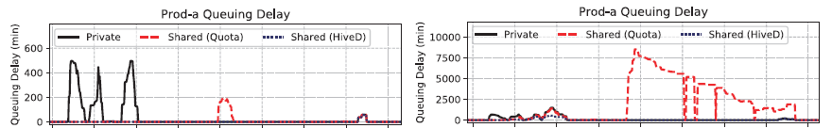
Evaluation
Sharing Safety and Cluster Load
Quota: there were more sharing anomalies under heavier loads
HiveD still eliminates them all
Heavier Load

Slide 34
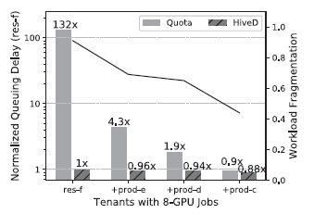
Evaluation
Sharing Safety and Workload Fragmentation
Quota: there were longer queueing delays with higher fragmentation level
HiveD: there was no significant difference
Higher Fragmentation

Slide 35
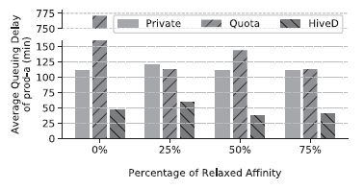
Evaluation
Sharing Safety and Soft Affinity Requirement
Quota: when increasing the percentage of soft affinity requirement, queueing delay first decreases but then increases
Although relaxing affinity reduces delay, it increases fragmentation
HiveD avoids the tradeoff altogether
More Soft Affinity Requirement

Slide 36
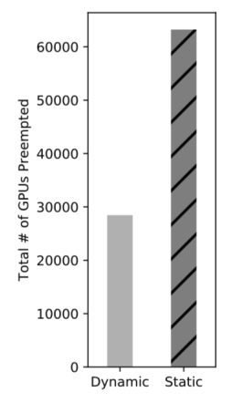
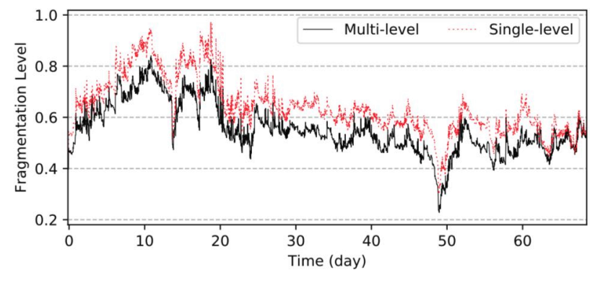
Evaluation
Buddy Cell Allocation
Dynamic binding reduce preemptions by 55% by avoiding dirty cells
Multi-level cells allow the algorithm to pack the cells at the same level across tenants to reduce the fragmentation

Slide 37
Evaluation
Key Findings
HiveD can:
Eliminates sharing anomalies found in all of the tested schedulers
Incorporates the state-of-the-art deep learning schedulers and complement them with sharing safety
Guarantees sharing safety under various cluster load, fragmentation level and affinity requirement
Use Buddy Cell Allocation to
reduce job preemption by 55%
reduce fragmentation of GPU affinity by up to 20%

Slide 38
Summary
HiveD addresses the challenge of sharing a multi-tenant GPU cluster by
Sharing Safety: a simple and practical guarantee
Cell and VC: A new affinity-aware resource abstraction
Buddy cell allocation: proven safety and support for low-priority jobs
Flexible architecture: to incorporate other scheduling goals while guaranteeing share safety

